Slide 1
IU Group Update
Doug Edmonds (Co-PI) & Jake Gearon (PhD Candidate)
Jan 3

Slide 2
Background/Bio
Doug Edmonds
PhD. Penn State 2009 in Geosciences
Expertise in fluvial sedimentology, sediment transport and fluid flow
Methodological interests, modeling (numerical forward modeling), remote sensing, informatics
Jake Gearon
B.S./M.S. UT Austin 2019/2021 – Geology
Started at IU in 2021
Focus: remote sensing of sedimentary surface processes, at-scale geoinformatics
PhD title: Investigating River Avulsion Dynamics with Large-Scale Remote Sensing Data Operations

Slide 3
Research Interests for this Project
Assess the status of national levee infrastructure
Height
Width
Vegetation Cover
Slope
Spatial Variability
What defects are detectable with remote sensing data?
Change detection on overtopped levees
Flynn, Stefan, Vahedifard, Farshid, and Schaaf, David. "A Dataset of Levee Overtopping Incidents." Geo-Extreme 2021: Proceedings, 2021, pp. 99-108. doi:10.1061/9780784483701.010. – NEED ACCESS!
enough events post 3DEP?
Notes:
Not enough time t lok at majority of levee systems, so much imagery, lidar, satellite data, we don’t know the basics about the levee. ERDC wants consistency, levee ecosystem. Basic info about risk assessment. Defects: what can remote sensing do for remote sensing defects and understanding? What can it detect?

Slide 4
Levee Informatics
National Levee Database – Access to quasi-standardized levee data
”Quasi” because the levee data does not appear always interoperable (different names, error acceptability for profiles, data completeness, etc)
Question for group: can we get API access? They have a SWAGGER API endpoint: https://levees.sec.usace.army.mil/developer/#/ but with sparse documentation. Would be good to be in contact with the dev team over there—they may even have a static version for us

Slide 5
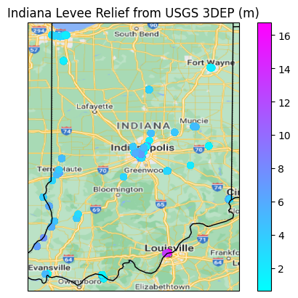
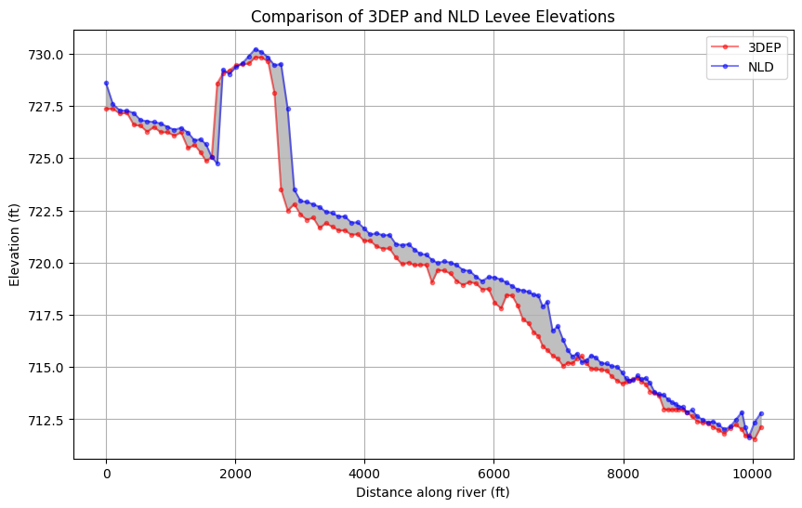
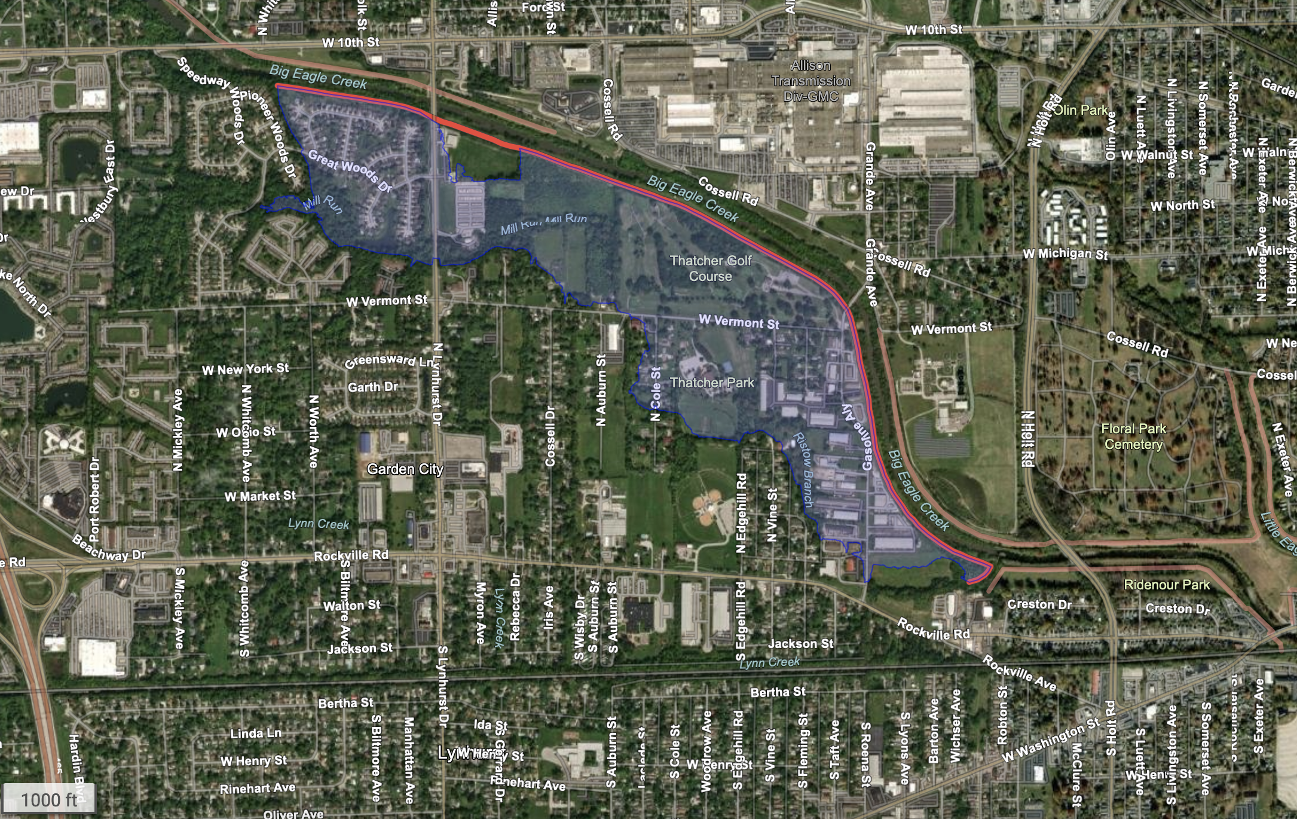
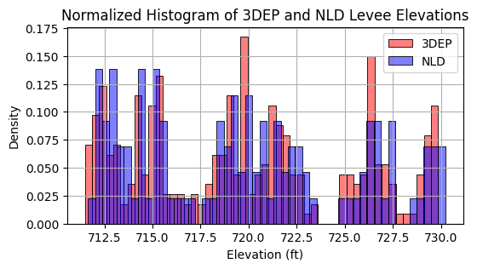
Indianapolis City Center ->
1000 ft

Slide 6
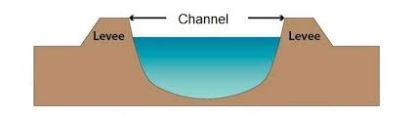
Information Missing from NLD
Tabular Height Data/Width or Slope!
Occasionally exists but reported as maximum (no spatial variability in geometric measurements)
Datum/Elevation source information for profile
NLD is “machine-readable” in name only in current form :/ (this is common with databases that have state/county data providers)

Slide 7
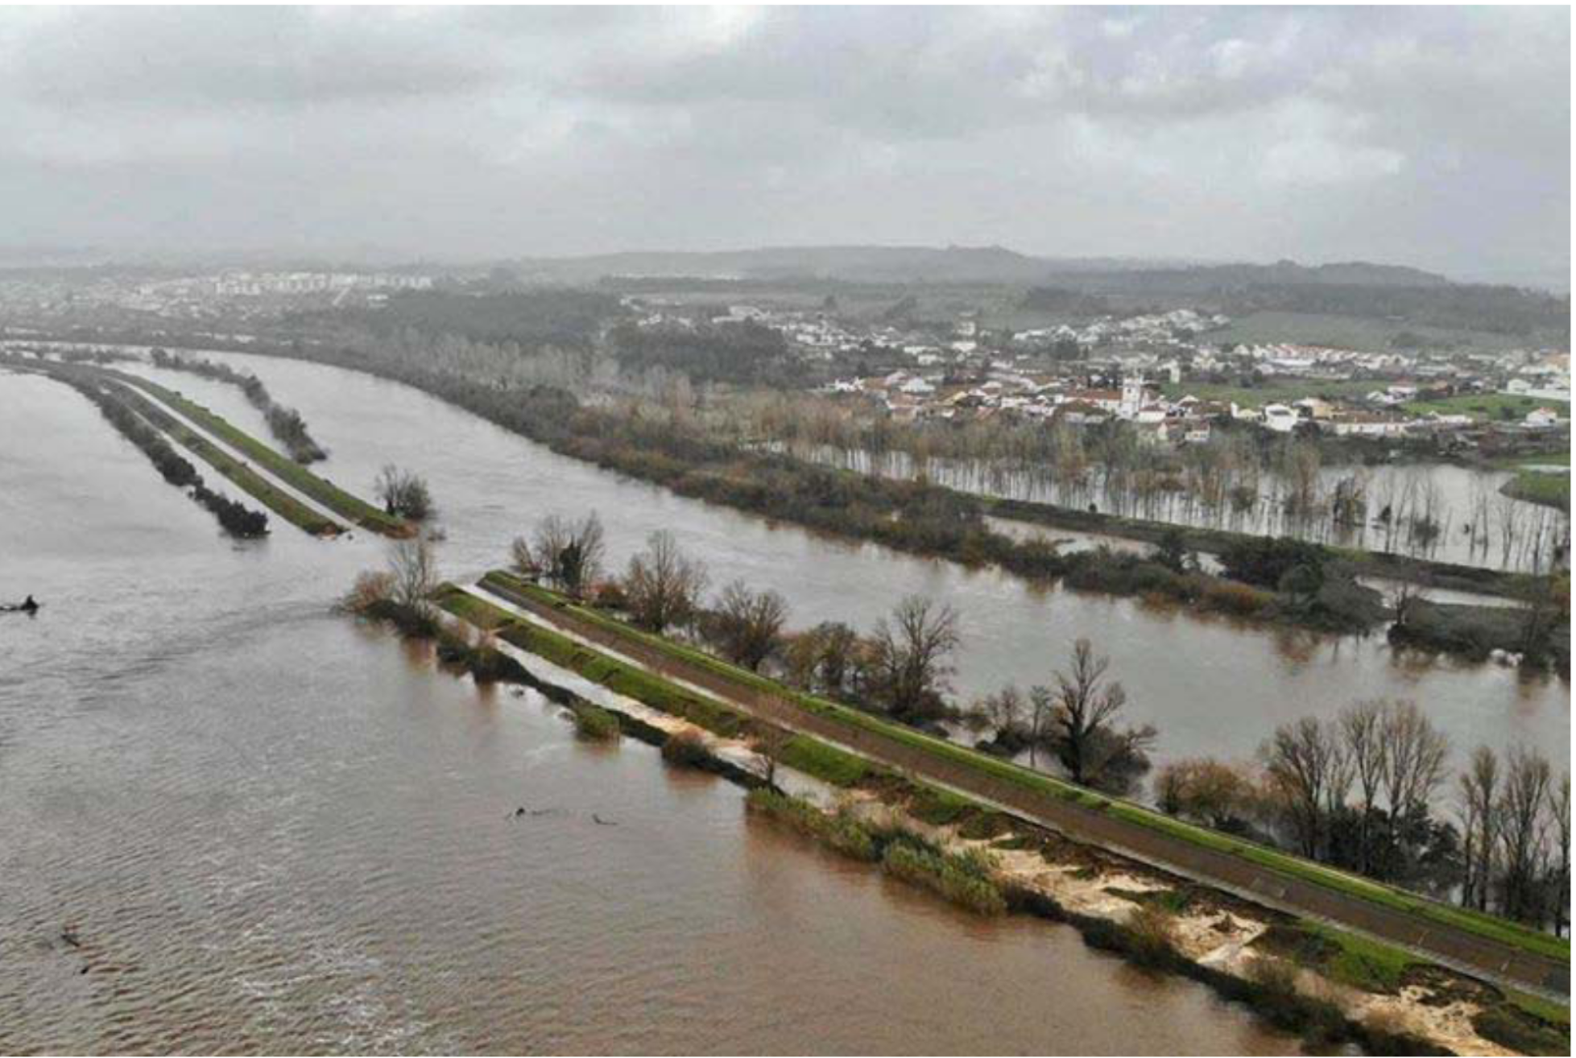
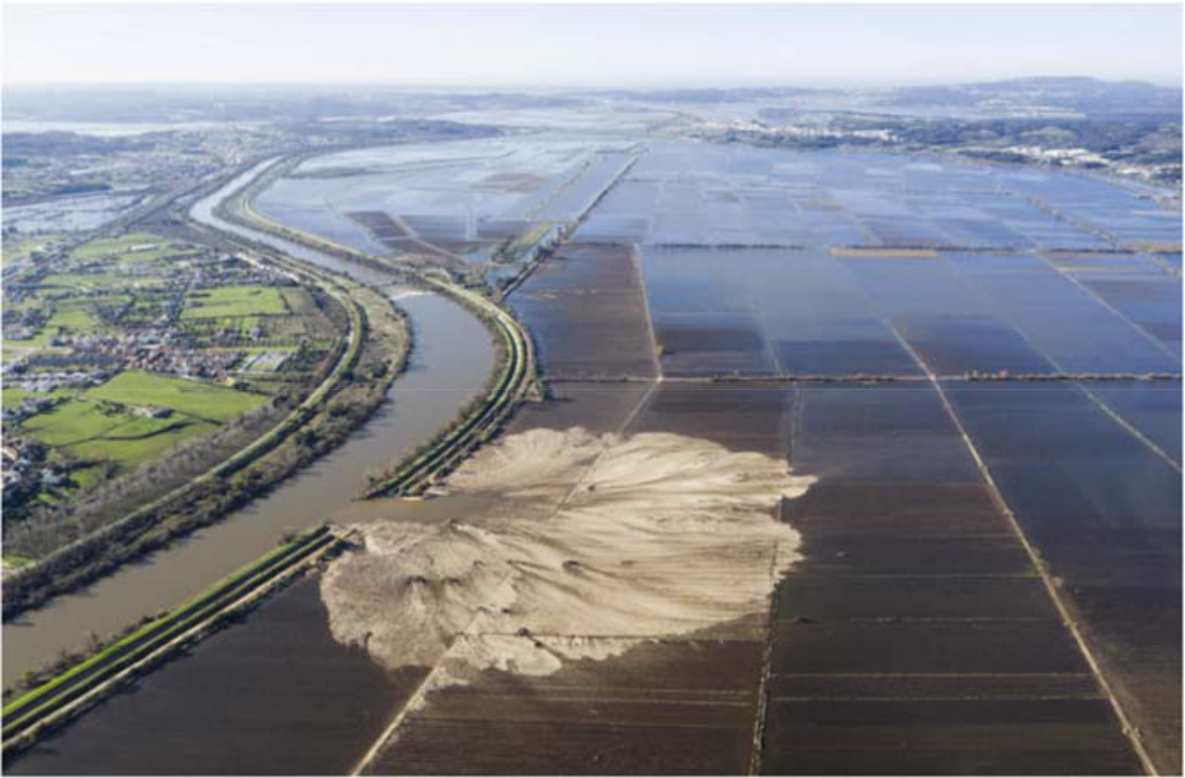
Levee Failures/Defects
Failed after a 19 m flood stage overtopped the levees designed for 18 m stage. Failure mode uncertain other than some observed overtopping scour. Generated a scour pit and sandy crevasse splay. –QUESTION after last meeting -> what can we see from space/for free?

Slide 8
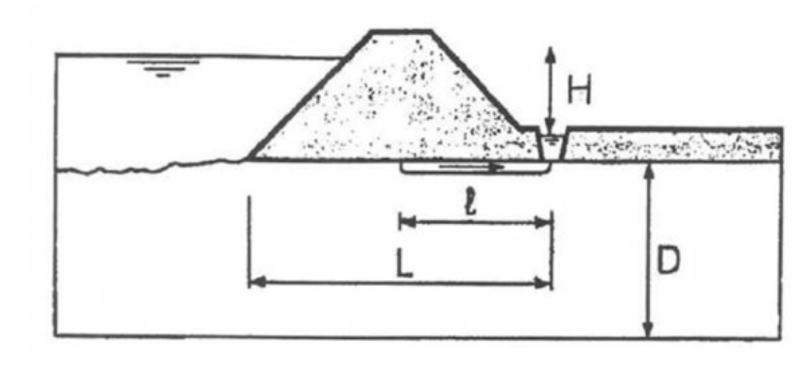
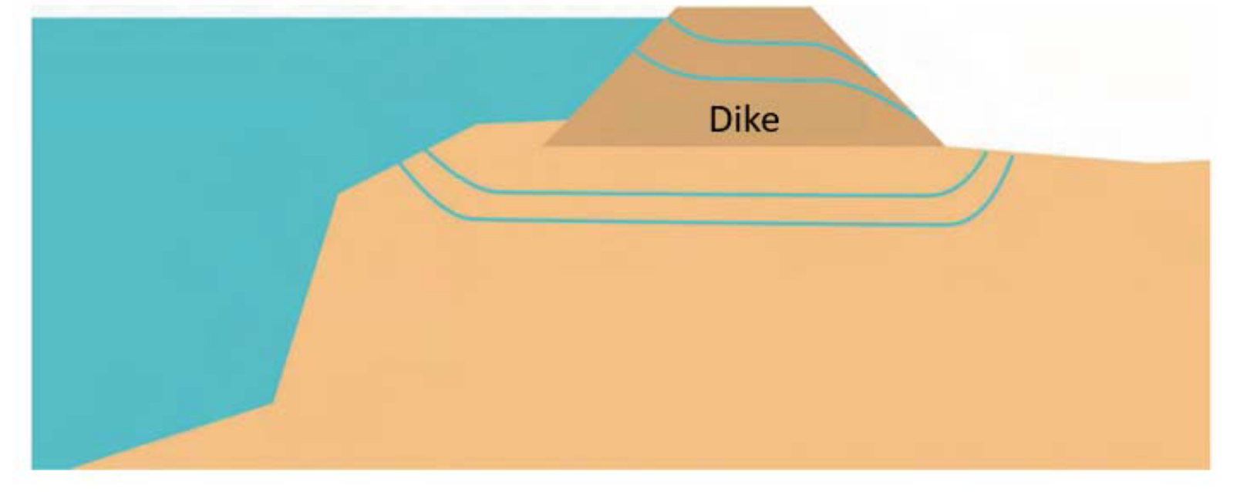
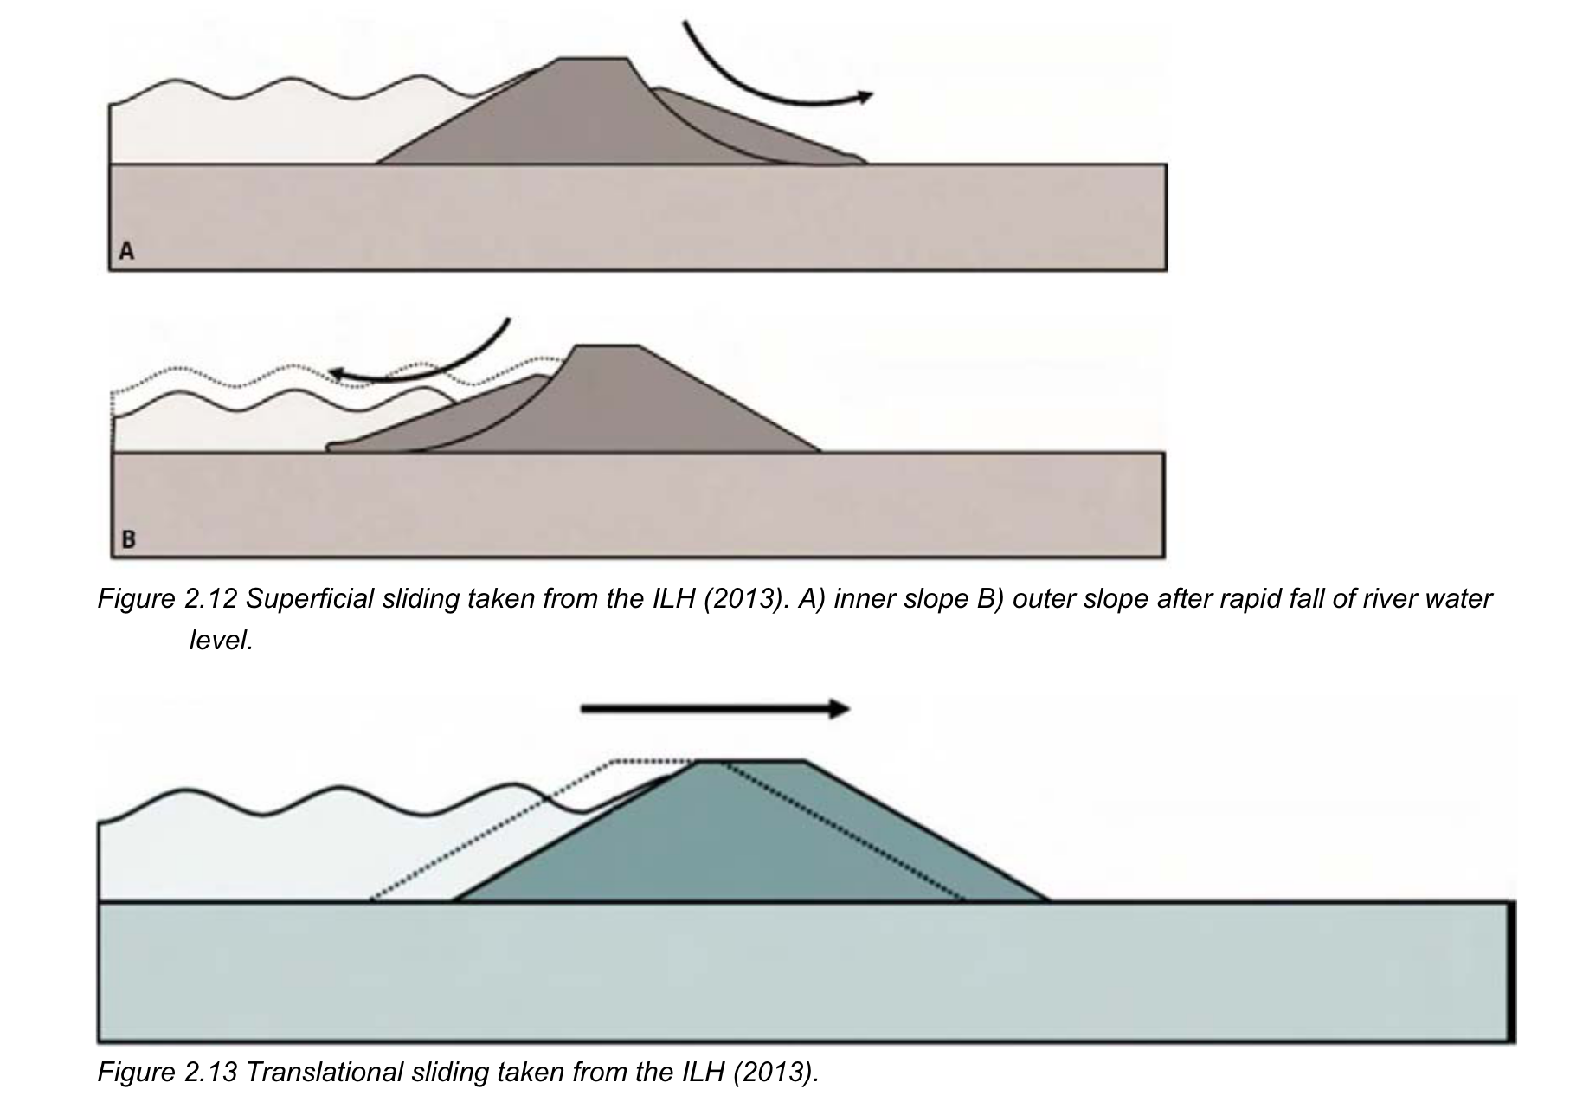
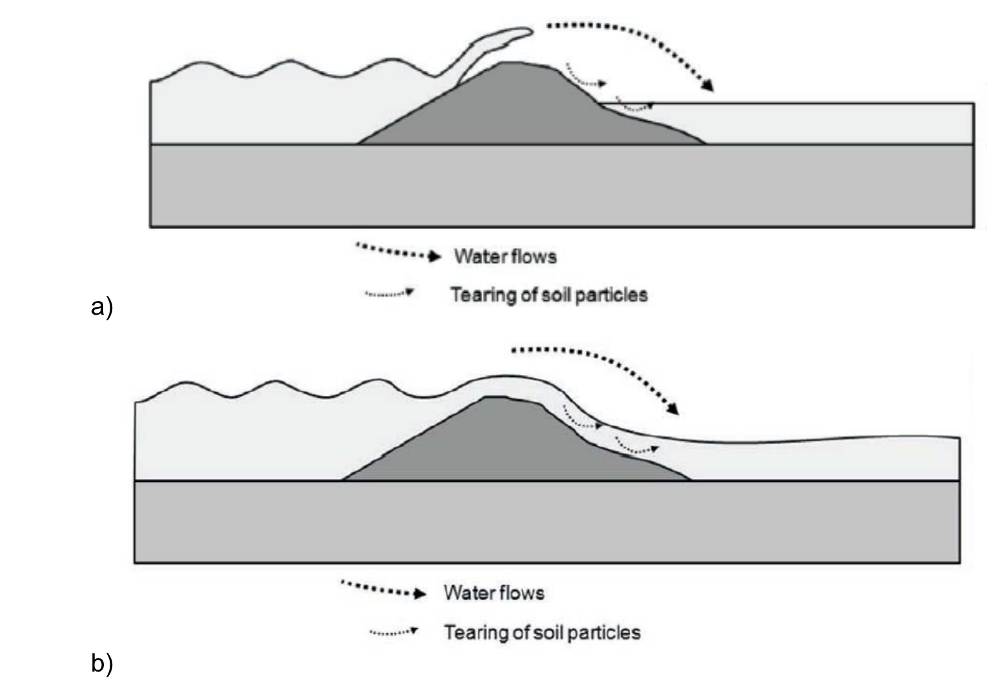
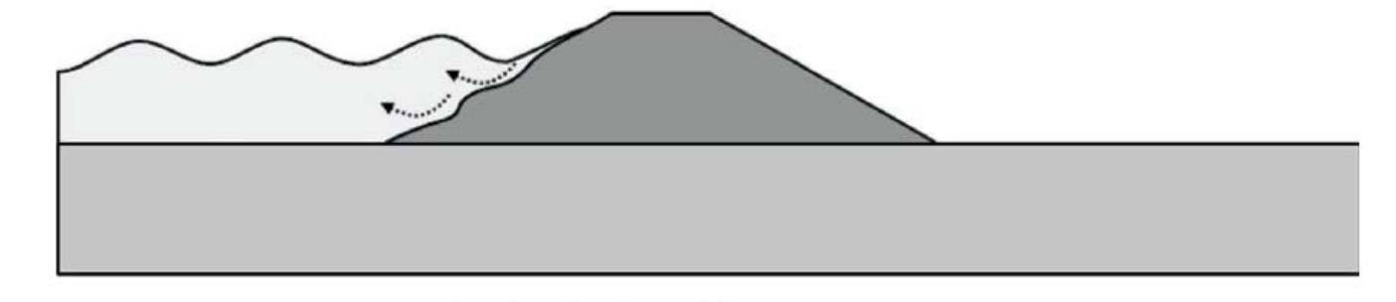
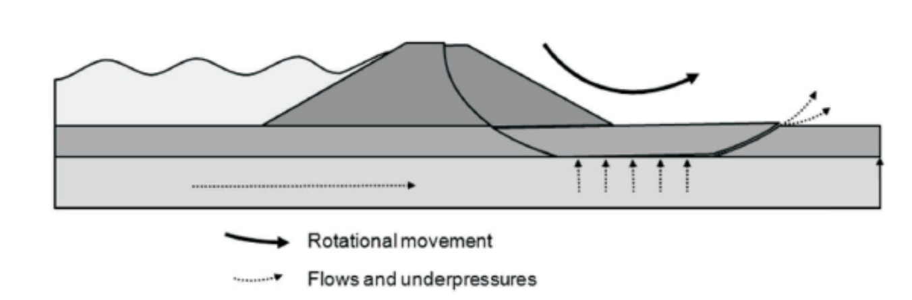
Some sedimentary considerations
“The shear stress applied by a 1 cm water layer on a 1:3 slope is ~ 31 Pa. Yet the acceptable [sic] shear stress on the ground ranges from 3 to 30 Pa. Therefore, even a low level of discharge can wear particles away. This eliminates the stabilizing force they provide to upstream particles, which can, in turn, be worn away. This mechanism is regressive”
PIPE FORMATION
SLIDING
LAND SIDE EXTERNAL EROSION
SEEPAGE
WATER SIDE EXTERNAL EROSION
UPHEAVAL

Slide 9
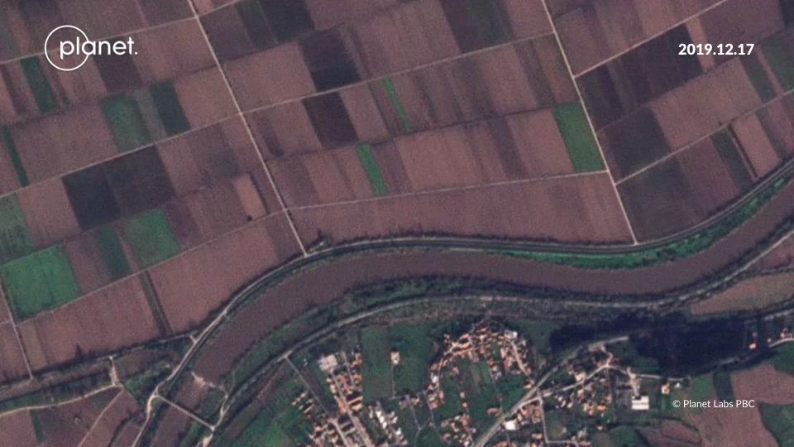
Santo Varão, Portugal
500 m

Slide 10
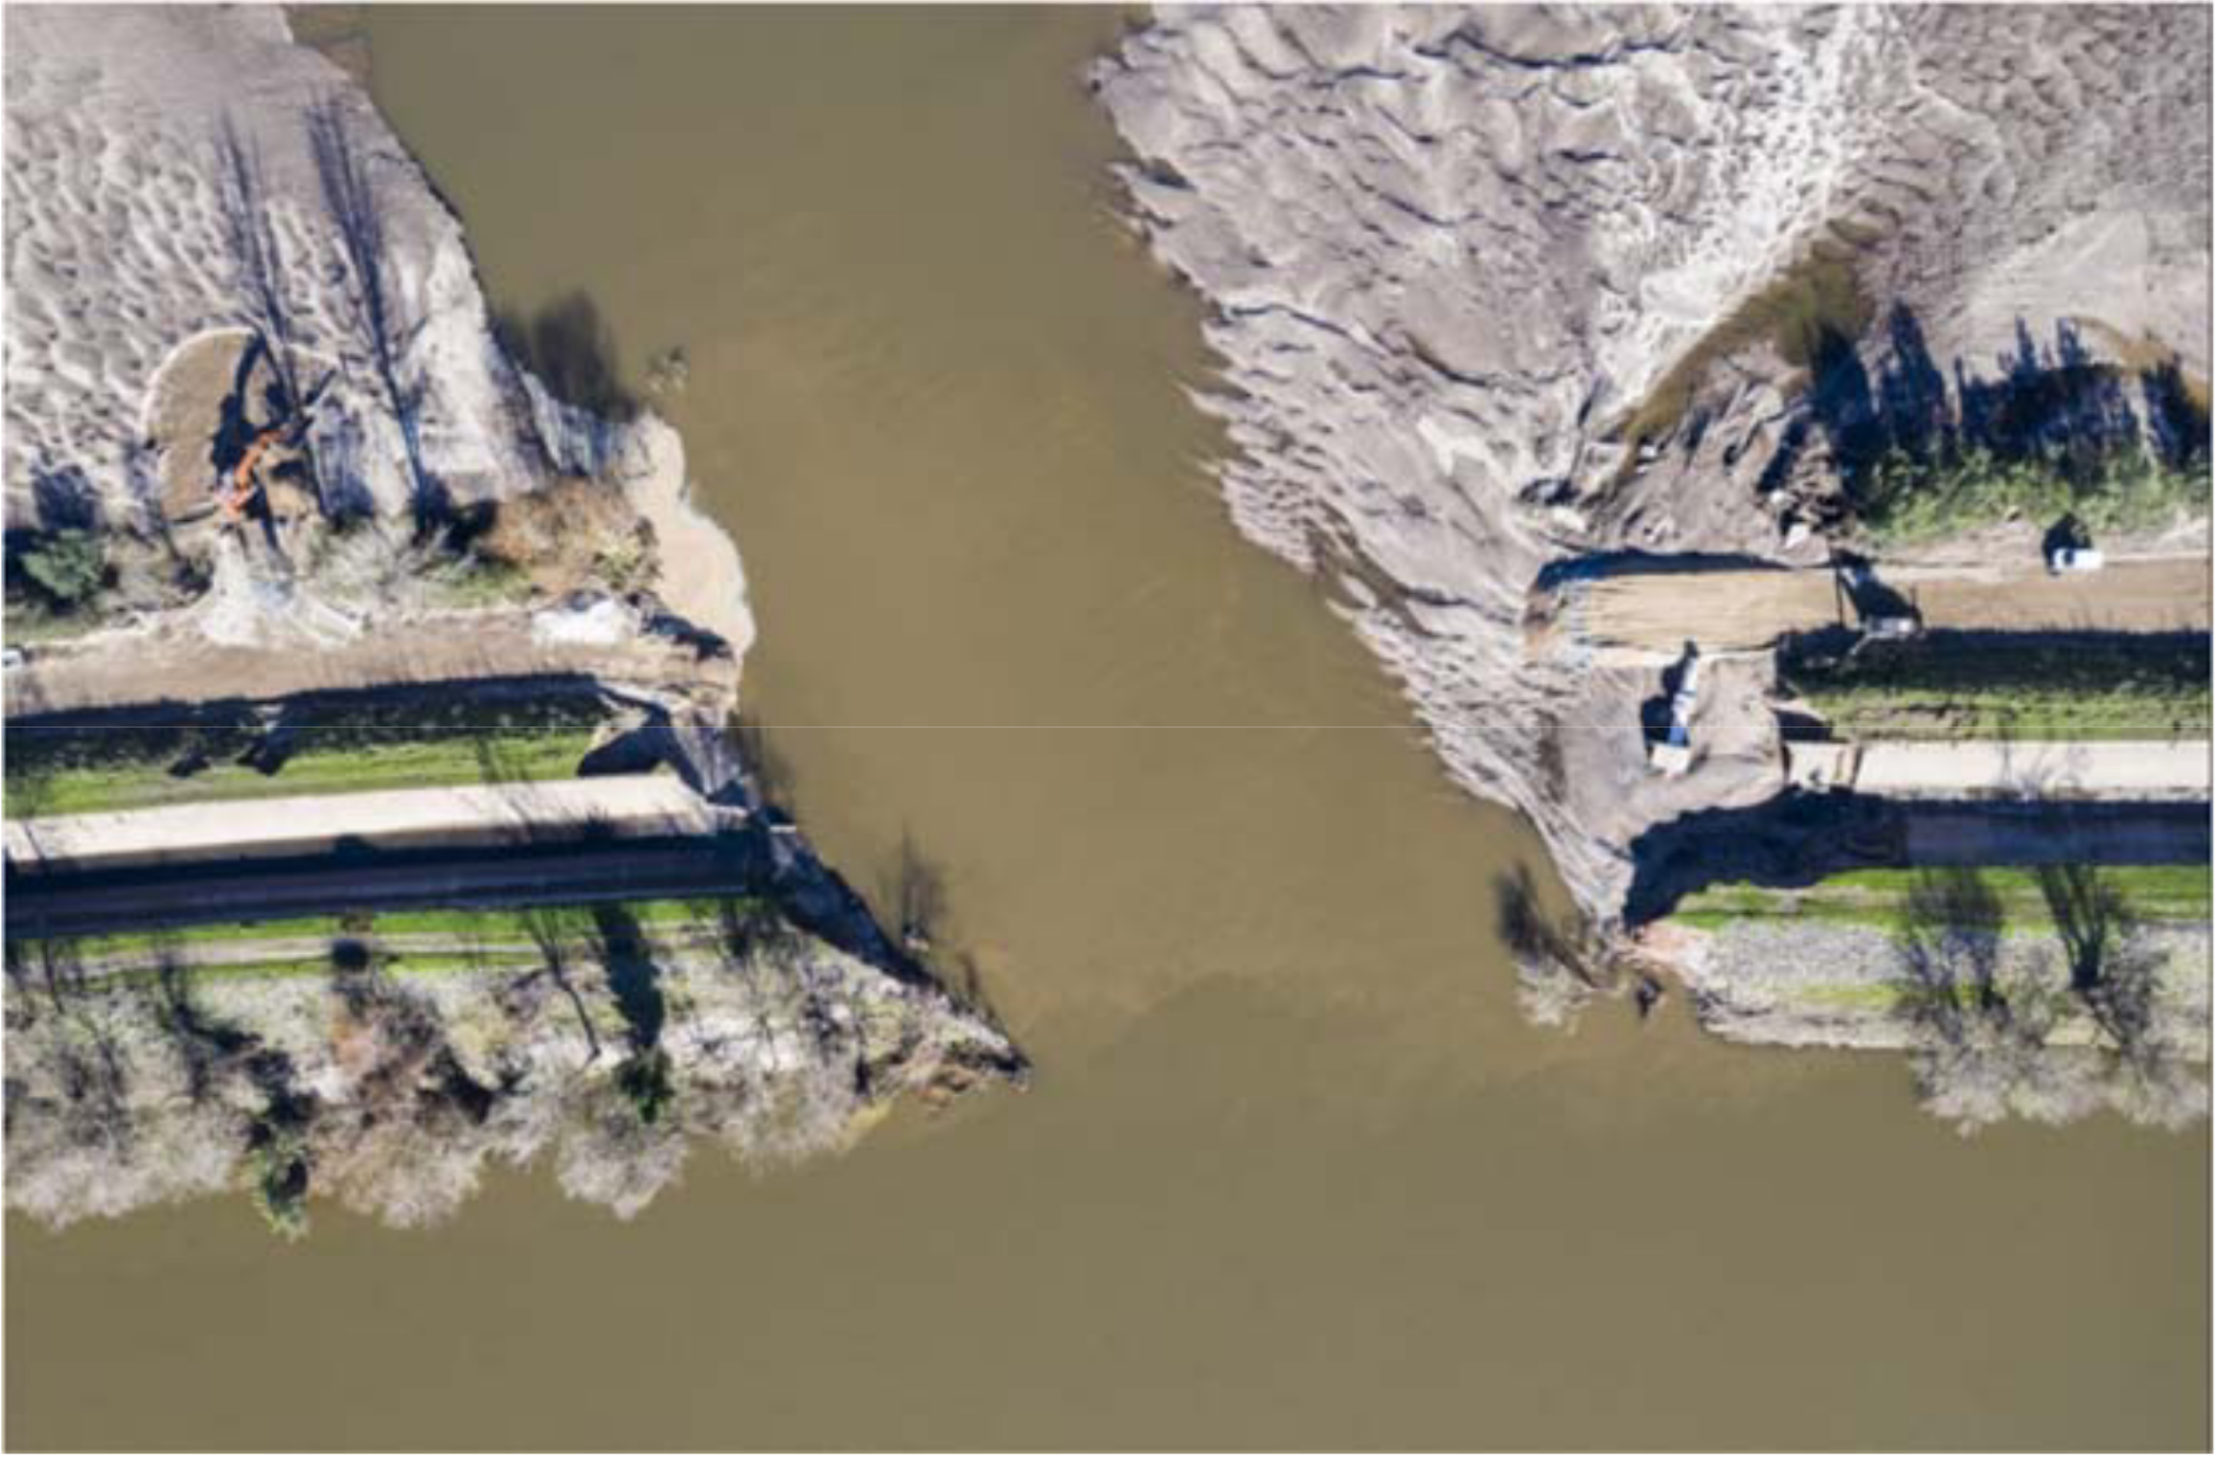
Overview of crevasse channel, scale unknown

Slide 11
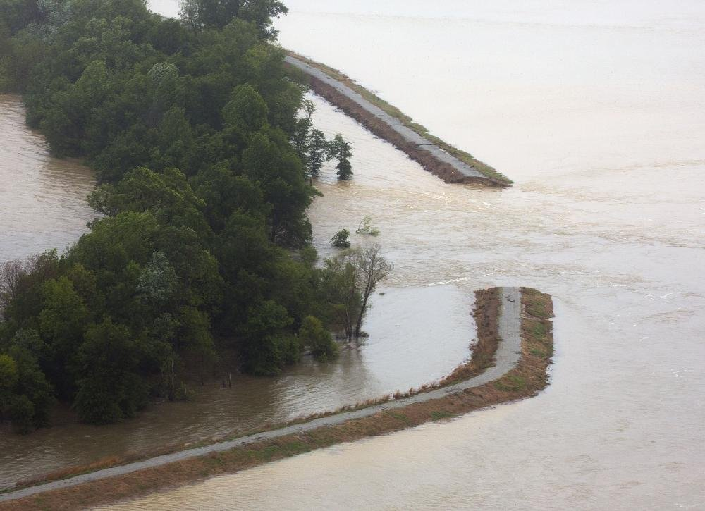
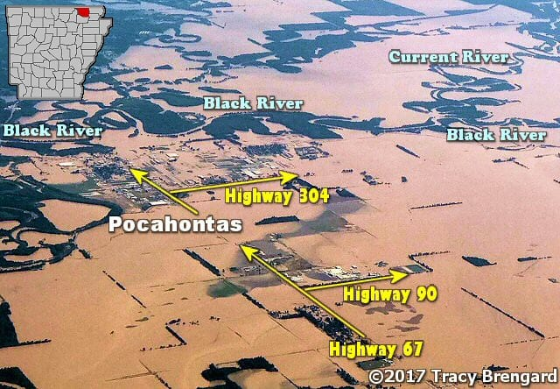
Pocahontas, AR

Slide 12
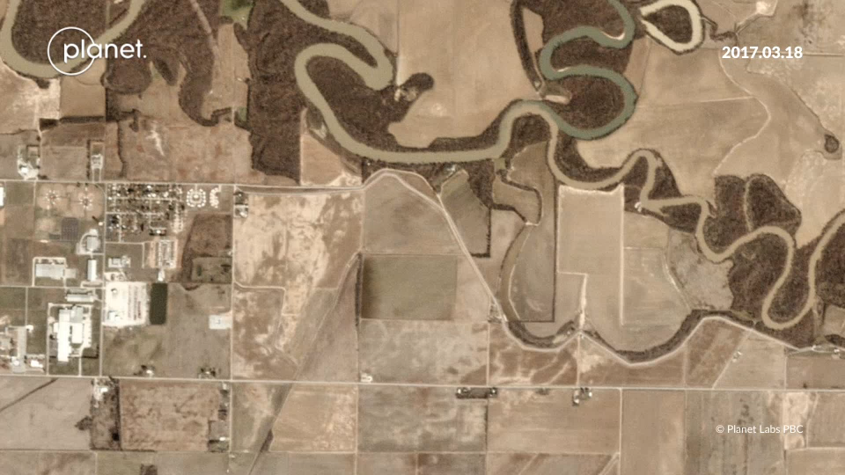
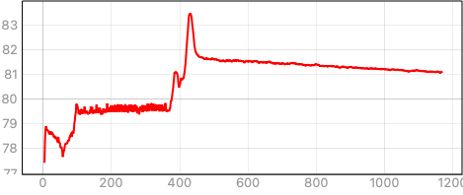

Slide 13
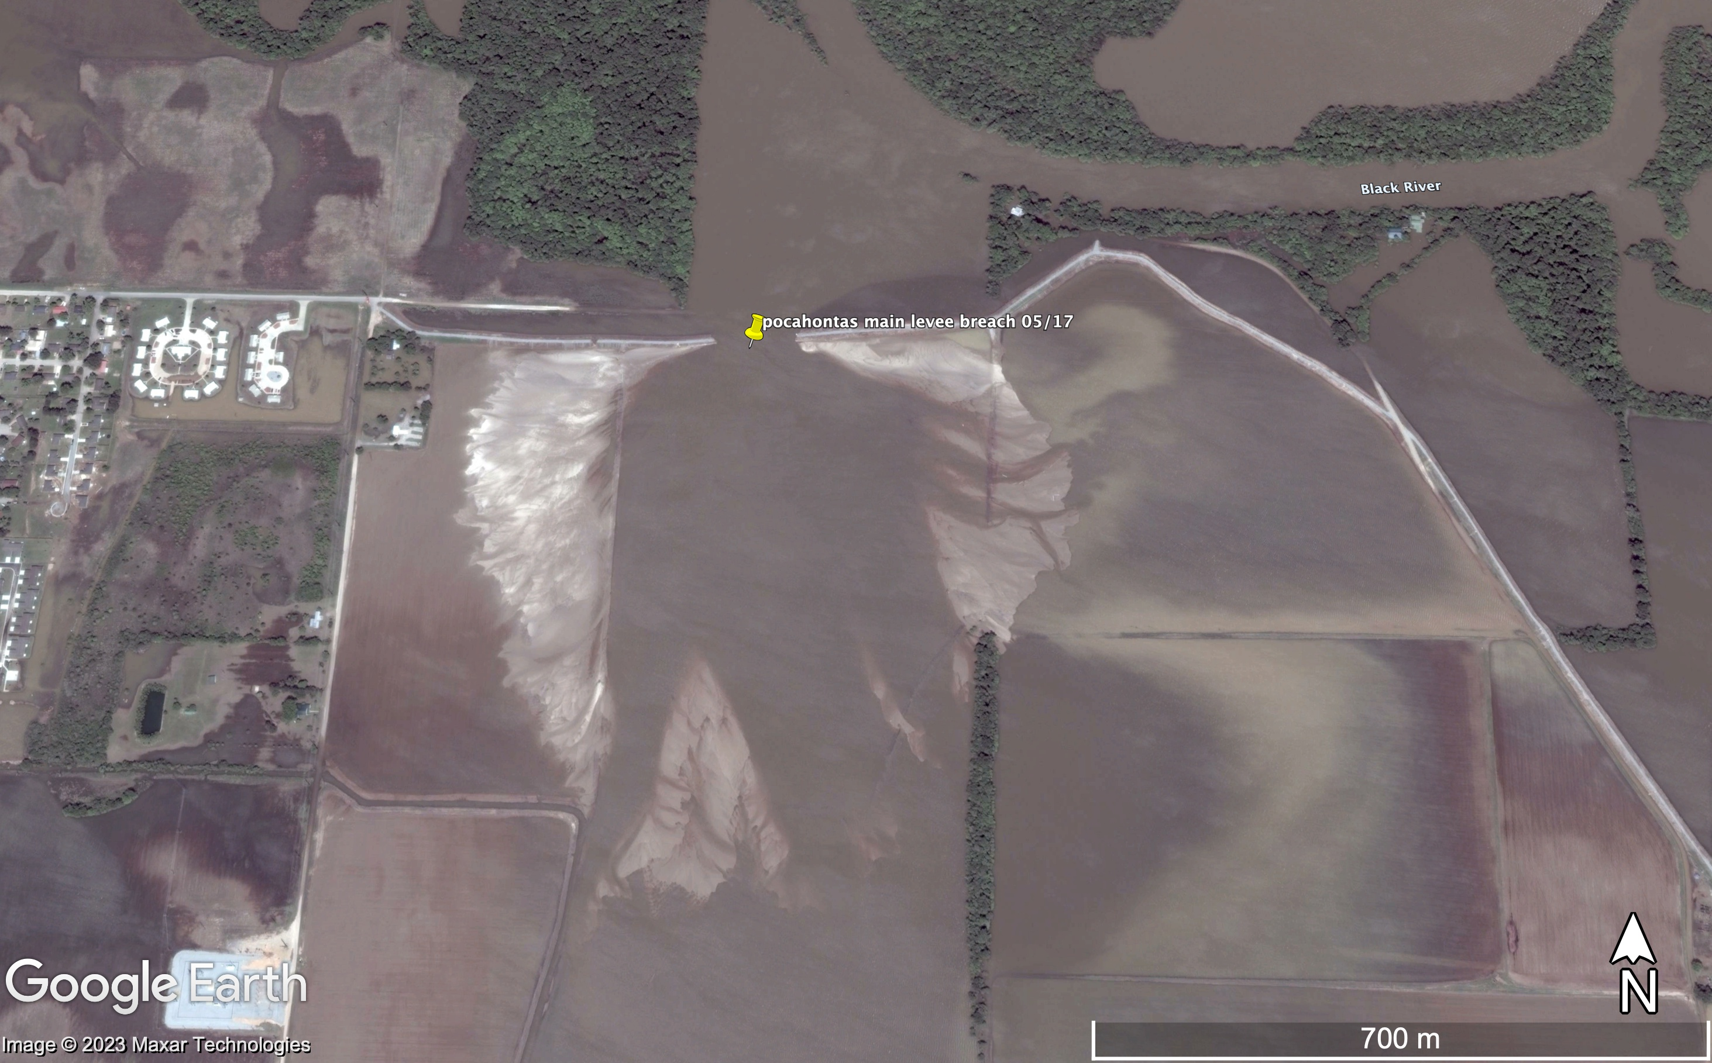
pre-event topographic profile
Slopebreak/knickpoint -> shallow receiving basin == constricted flow -> lower capacity -> sand splay deposition

Slide 14
Steady-State Shear Stress Calculations
4.5 Pa
3.6 Pa
75 Pa !
pre-event topographic profile
Bankfull flow bed shear stress estimate
Width = 80 m, Depth = 4.6 m -> R = 4.1 m, Slope = .00009 m/m
~ 3.6 Pa
Estimate of breaching shear stress
Depth = .1 m (pre-event topography), Slope = .076 m/m (pre-event topography)
~ 75 Pa
Breached Farmland Slope bed shear stress estimate
Width = 385 m (imagery), Depth = 0.5 (estimate), Slope = .00092 (pre-event topography)
~ 4.5 Pa
Estimated critical shear stress of levee surface. ~ 3 - 30 Pa

Slide 15
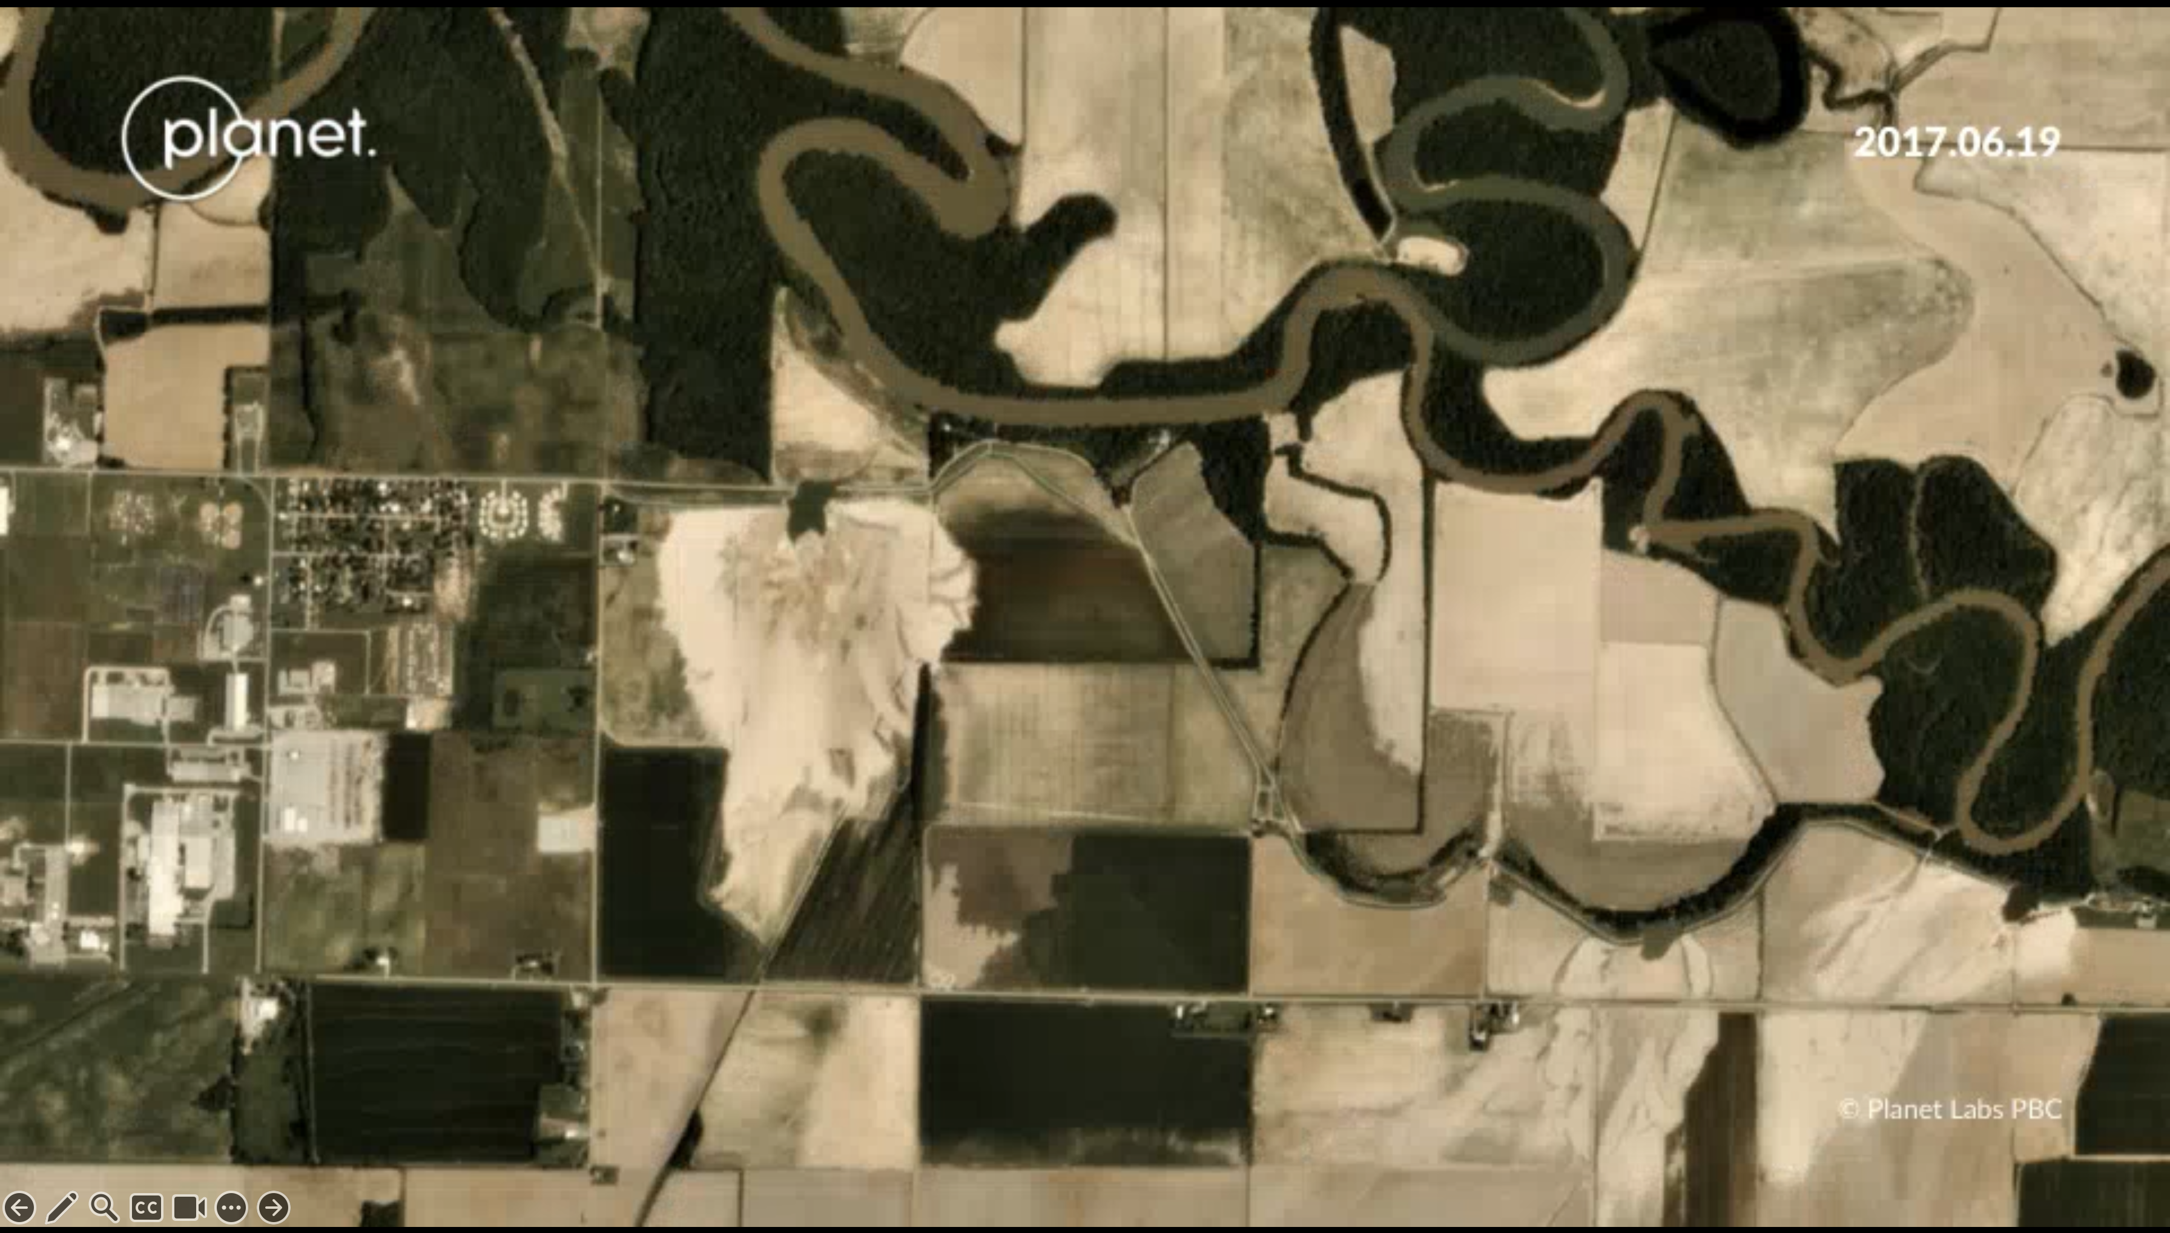
High shear stress on steep levees leads to plunge-pools known as “Kolk Lakes” which can be 10+ meters deep

Slide 16
Interesting notes/takeaways
Levee breaches in the US (often lowland, large, alluvial rivers) are often on the order of ~ 100 m. This number seems to crop up everywhere as a rule of thumb and on inspection of some data here and therefore we are surprised at its consistency…
Levee failures can happen seemingly due to any small imperfection in the earthwork-> burrows, sand/gravel lenses can lead to piping etc.
As such, maybe its better to ’zoom out’ and look at what sections along a river may be prone to excess hydrostatic pressure/overtopping. -> but how?

Slide 17
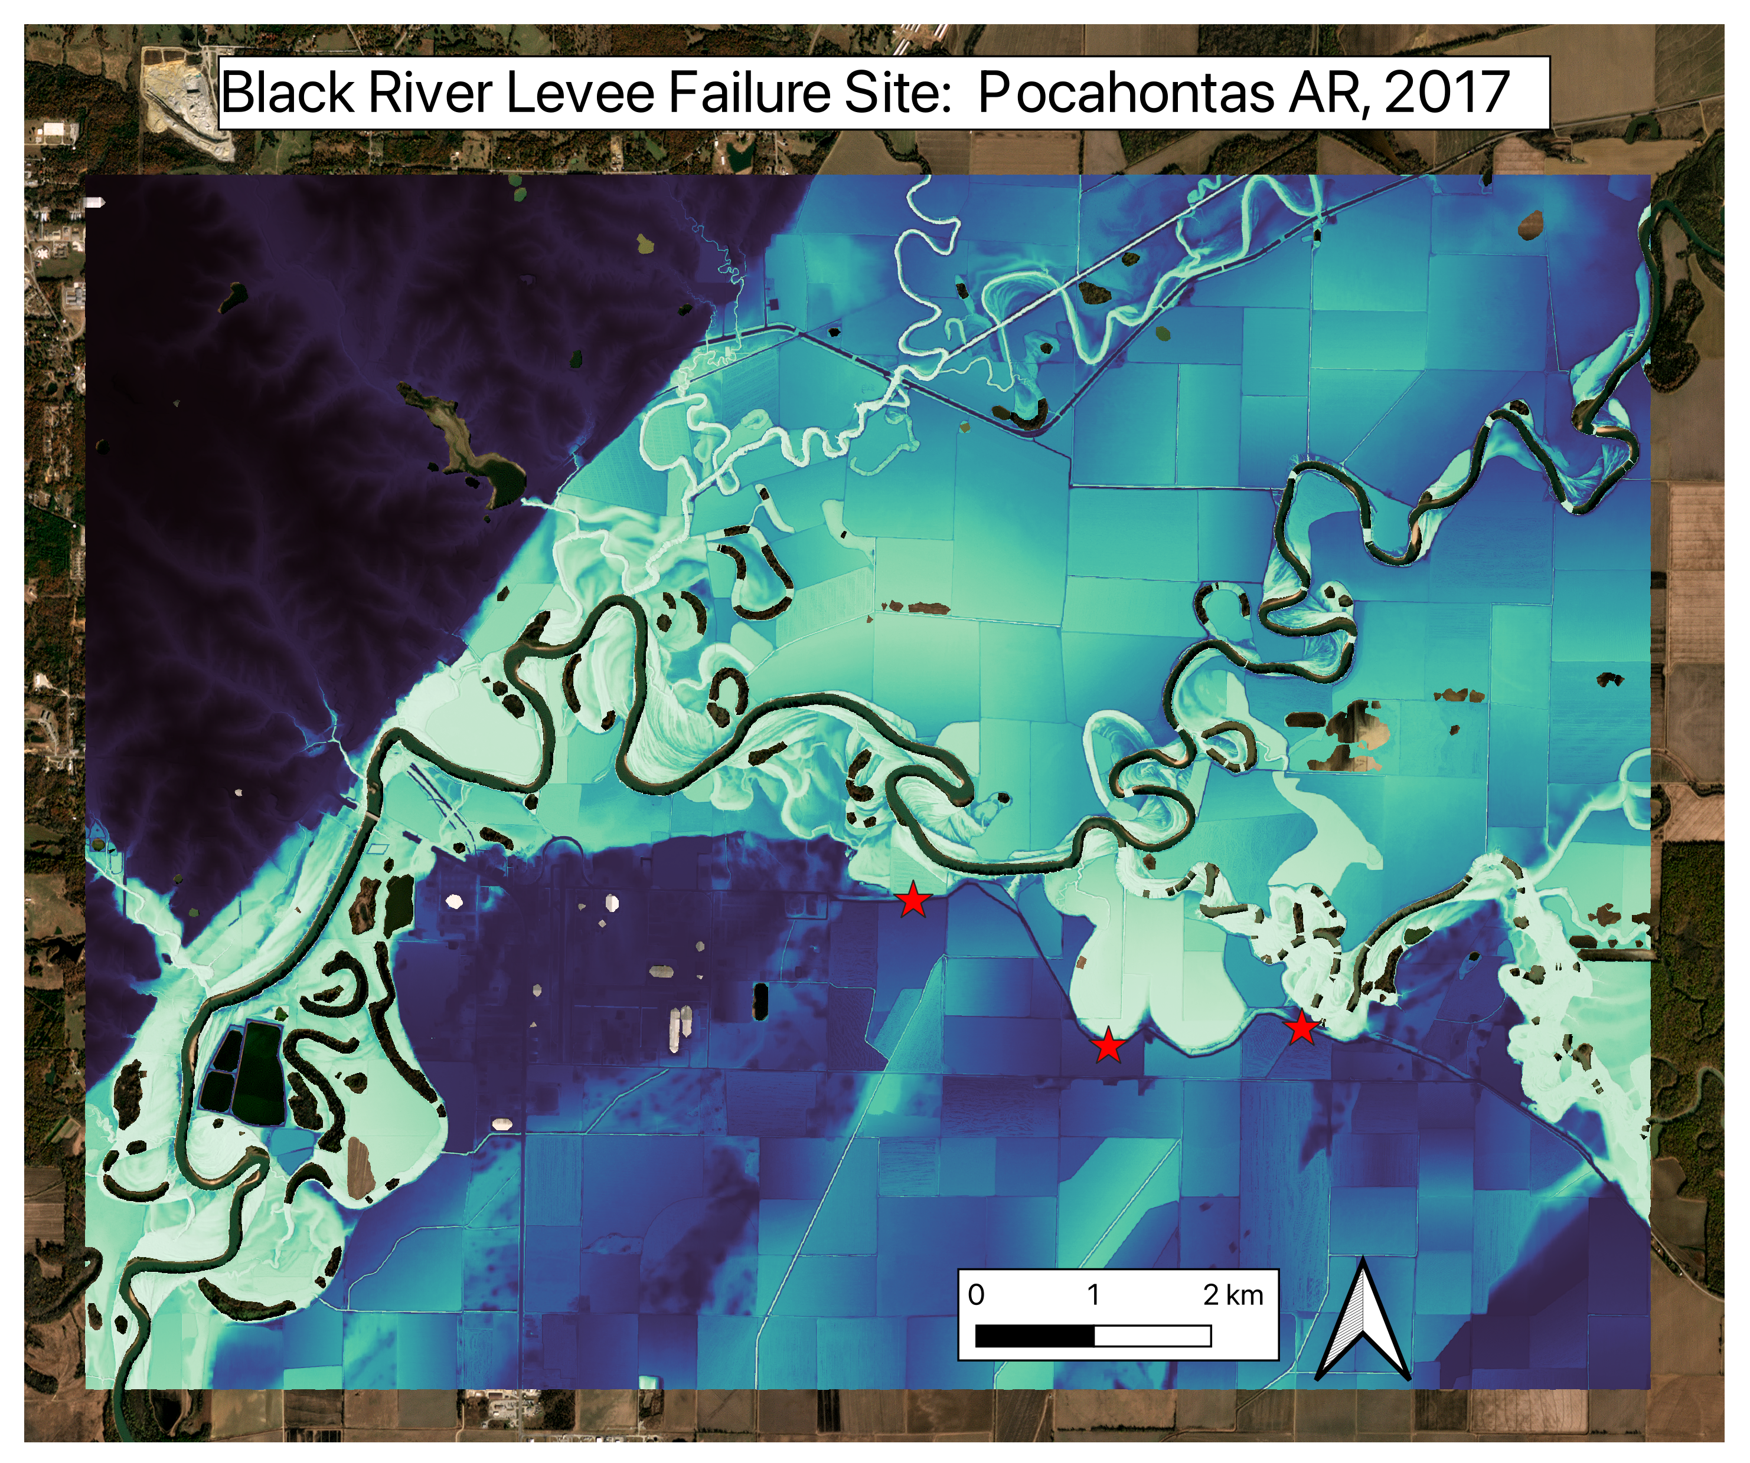
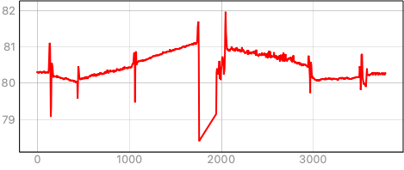
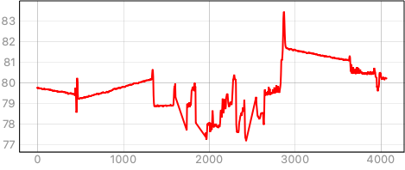
A possible direction: Meso-scale context: alluvial ridges
A’
A
A’
B
A
B
B’
B’
Notes:
If we can convincingly say that these gages are aggrading centimeters a year! Those dots we looked at

Slide 18
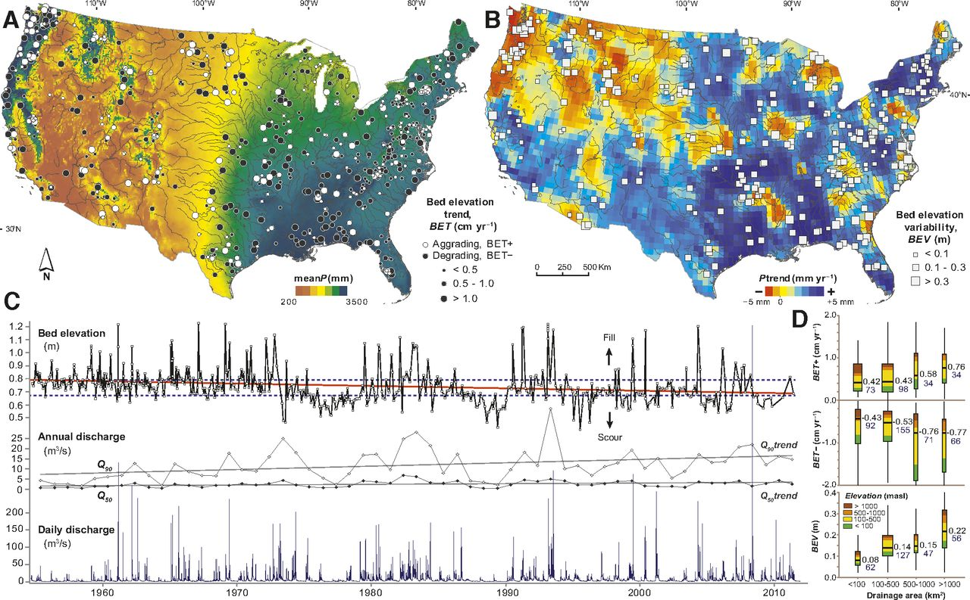
Sedimentation Trends
In the Midwest, streams are degrading as well as aggrading, hard to say as of now whether the Black River at Pocahontas has been recently aggrading or not. Alluvial ridge lifecycle is not well known.
Louise J. Slater, Michael Bliss Singer; Imprint of climate and climate change in alluvial riverbeds: Continental United States, 1950-2011. Geology 2013;; 41 (5): 595–598. doi: https://doi.org/10.1130/G34070.1

Slide 19
Some Good Resources
Van, M.A., Rosenbrand, E., Tourment, R., Smith, P. and Zwanenburg, C. Failure paths for levees. International Society of Soil mechanics and Geotechnical Engineering (ISSMGE) – Technical Committee TC201 ‘Geotechnical aspects of dikes and levees’, February 2022. Download https://doi.org/10.53243/R0006
G. Degoutte, R. Tourment (eds), 2021. Spillways on River Levees. Versailles, Ed. Quæ, 184 p. DOI: 10.35690/978-2-7592-3285-7
Morris, Mark William (2013). Breaching of earth embankments and dams. PhD thesis The Open University.
Perlea, Mary P.; Pearce, Robert L.; Lust, Kathleen E.; and Detrick, Charles W., "Repair of Scour Holes and Levees After the 1993 Flood" (1998). International Conference on Case Histories in Geotechnical Engineering. 19.
Flynn, Stefan, Vahedifard, Farshid, and Schaaf, David. "A Dataset of Levee Overtopping Incidents." Geo-Extreme 2021: Proceedings, 2021, pp. 99-108. doi:10.1061/9780784483701.010. – NEED ACCESS!

